Slide 1





IDS517-Project
WEB APPLICATION FOR E-COMMERCE INVENTORY MANAGEMENT

Slide 2




Group Policy
Availability
Communication
Team Rules
In the beginning, we organized a WhatsApp group and asked everybody's flexibility.
Schedule zoom meetings to discuss about the project and the code development.
If anyone is not available for the calls or need some time off, they need to inform the team through WhatsApp
WhatsApp – To connect with the team whenever needed.
Zoom – Every day, the team meets to discuss the work that has been completed and the work that remains to be completed by the team members.
Asana – To keep track of the tasks done by the team members
No one can procrastinate their work without a valid reason.
Free riders will be reported to the professor.
Team members should help each other and work collaboratively.
Team members should be open about their problems of their tasks.

Slide 3









Communication Tools
Zoom
Zoom
Virtual meetings
WhatsApp
Text communication
PowerPoint
Slides/Presentation
Asana
PM Tool
Visual Studio
Code Development
Google Doc
File Sharing

Slide 4

Business Area
Wide variety of different products and brands with a highly competitive market
Lack of management system adhering exclusively to e-commerce platforms.
Huge diversity in terms of cost, quantities. relevant to specific product category.
Need for an e-commerce Management System.
Huge market and demand for accessories and gadgets bought online.

Slide 5







Software Development Lifecycle
1
3
5
Scope, assignment of tasks, policies and project management
Testing
Design
UML/flowcharts to design the software
Tests and iterations to assess the quality and readiness for deployment
2
6
4
Requirement Analysis
Implementation
Initiated when the product is in full operation with the client.
E-commerce industry requirements, key datasets and functionalities
Code development using HTML, CSS, Javascript

Slide 6


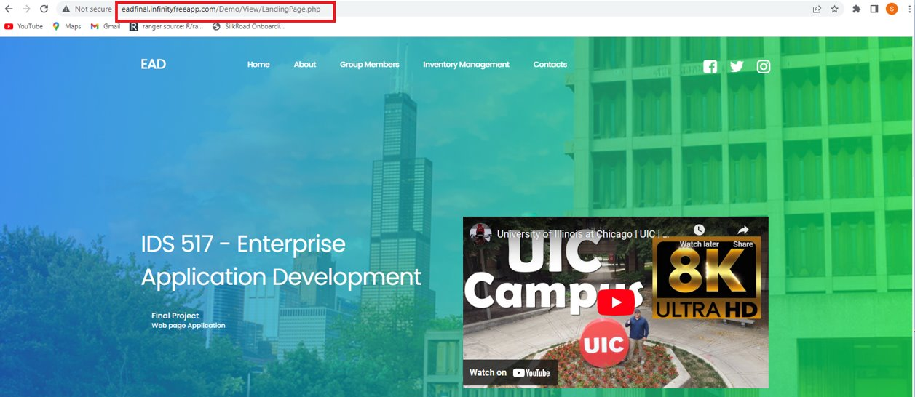
Application features
Landing page - http://eadfinal.infinityfreeapp.com/Demo/View/LandingPage.php
Multiple Menu with navigation for all items in menu
Multimedia file

Slide 7
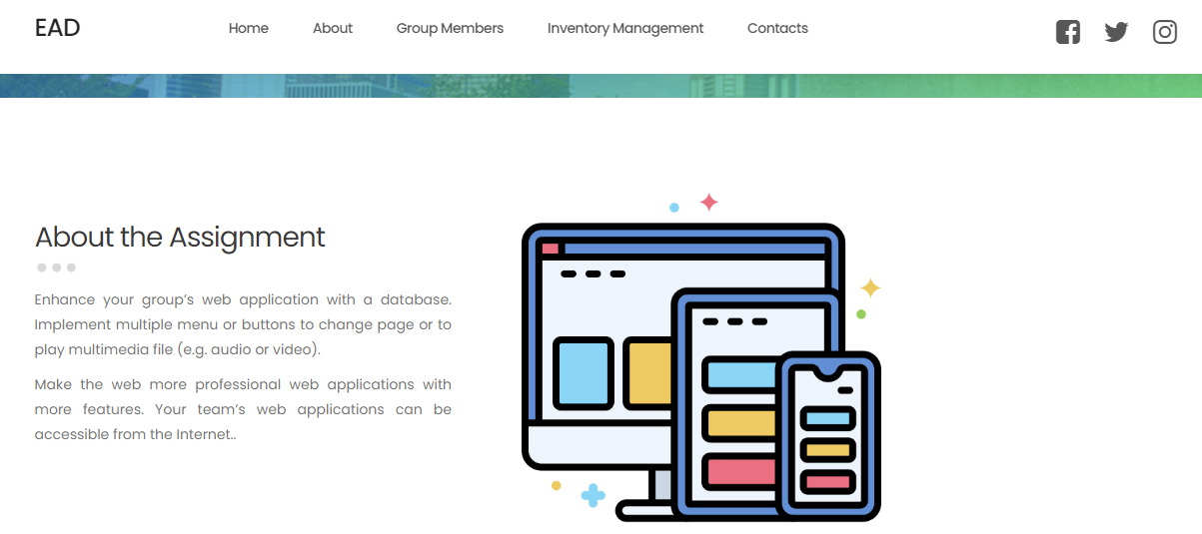
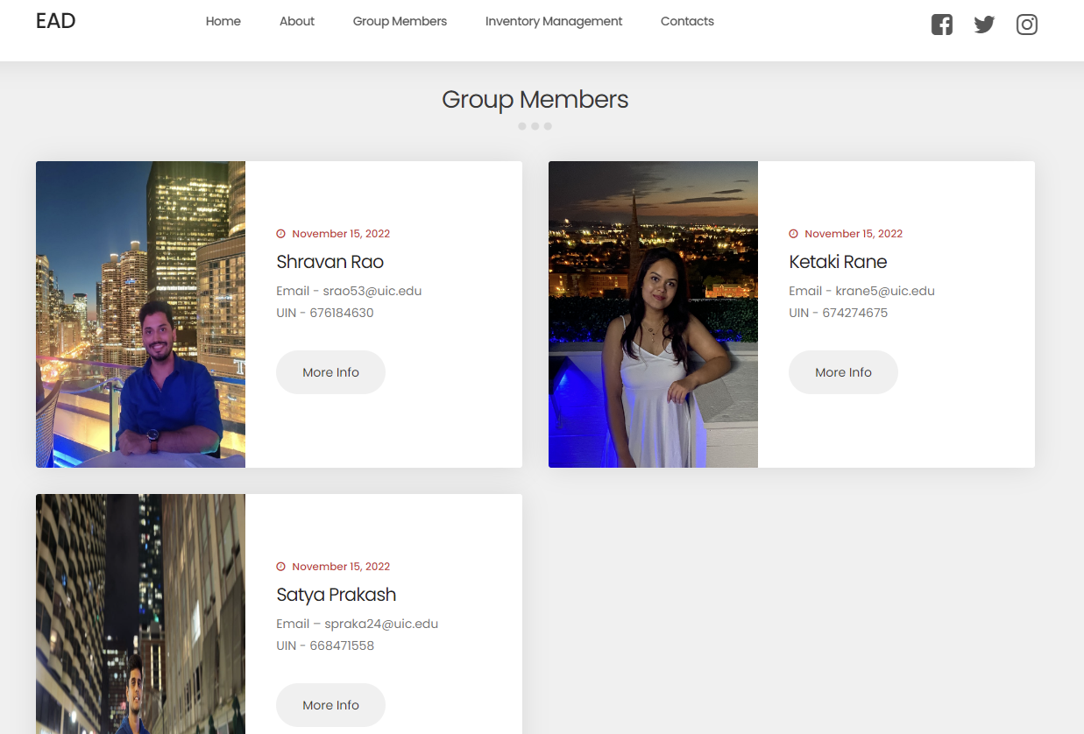
Application features
About Section
Group Member's profile
A dedicated page to view detailed information about each group member by clicking on respective More Info button.

Slide 8
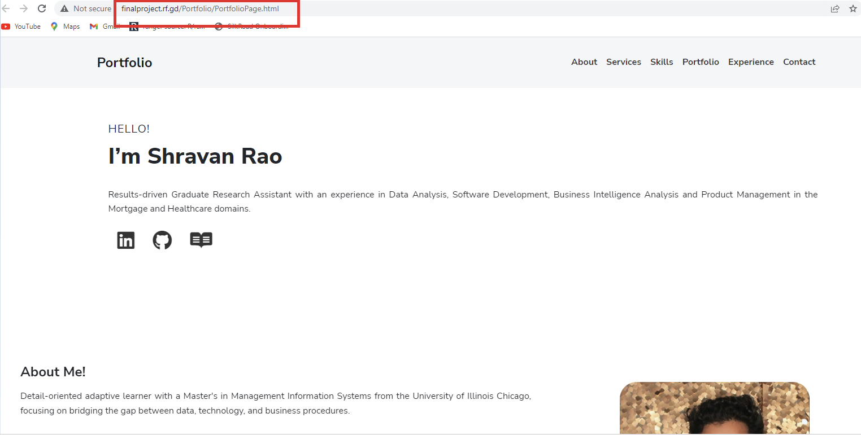

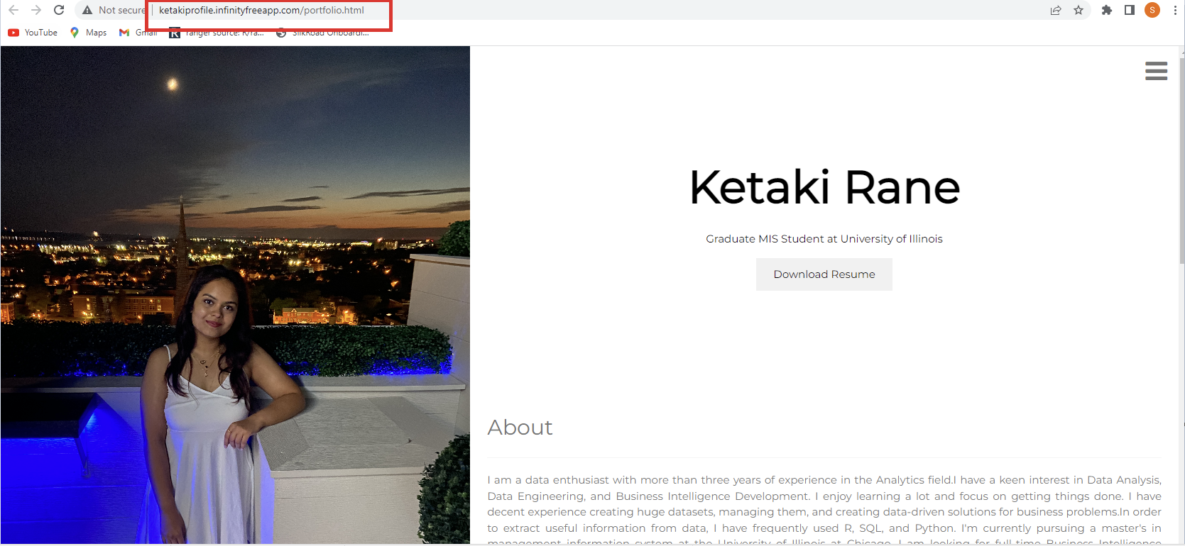
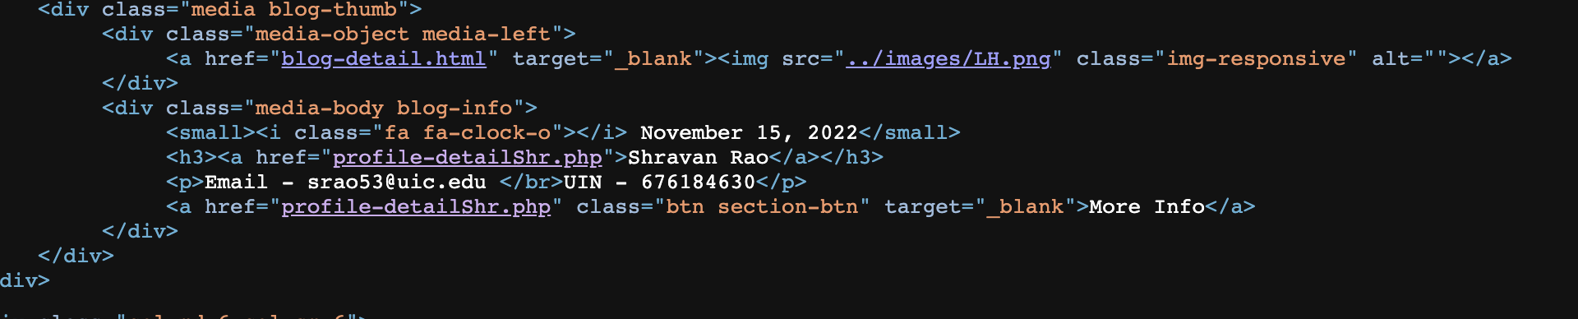
Application features
Individual Profile Pages
This code is used to open a new webpage in browser after clicking on More Info button

Slide 9
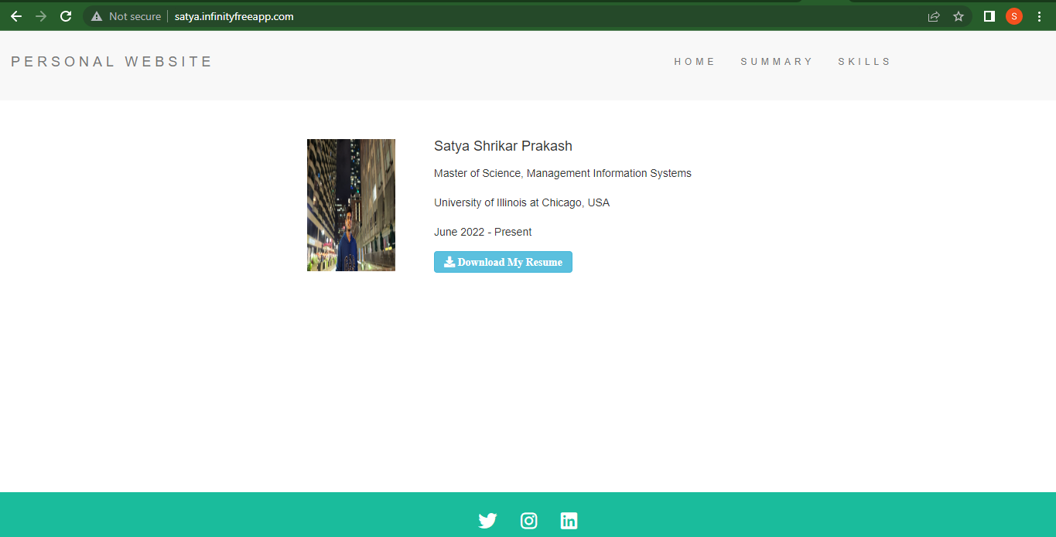
Application features
Individual Profile Pages

Slide 10
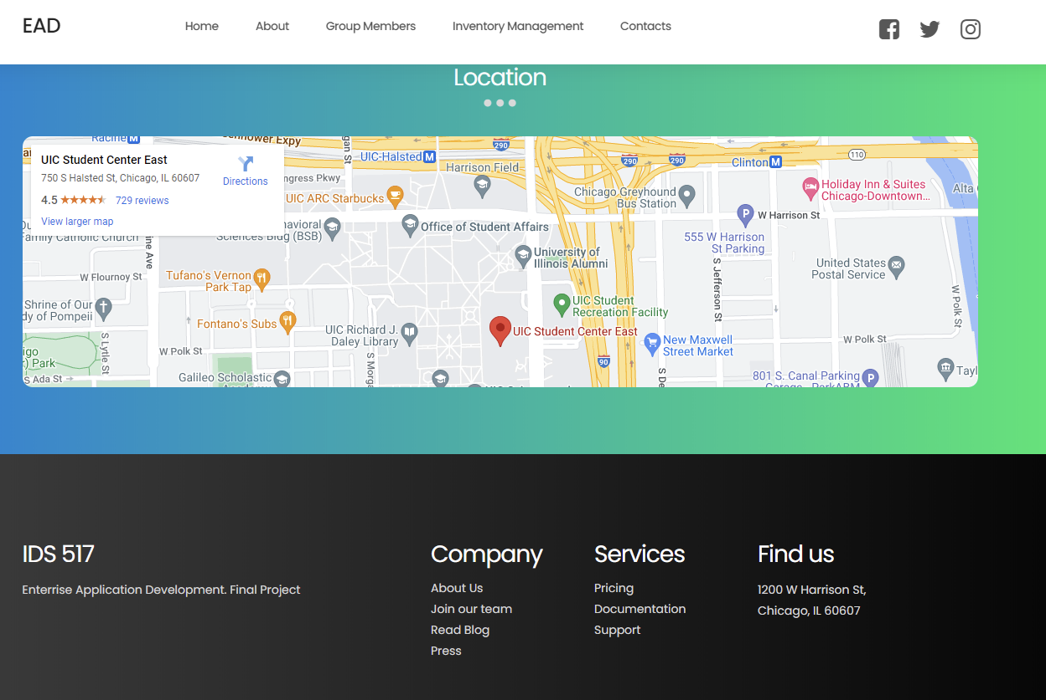

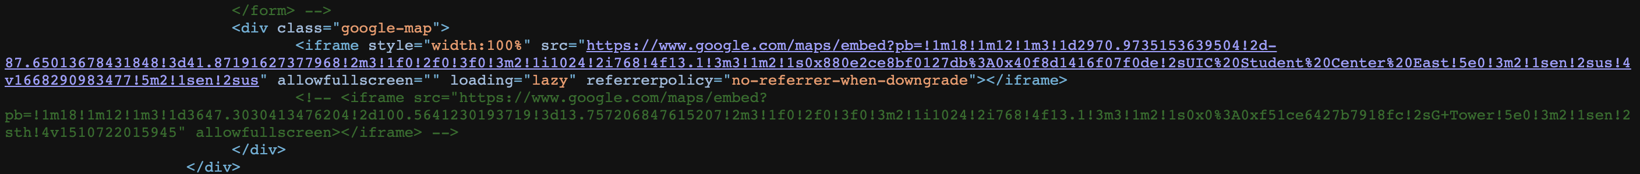
Application features
Location
Code for adding location

Slide 11


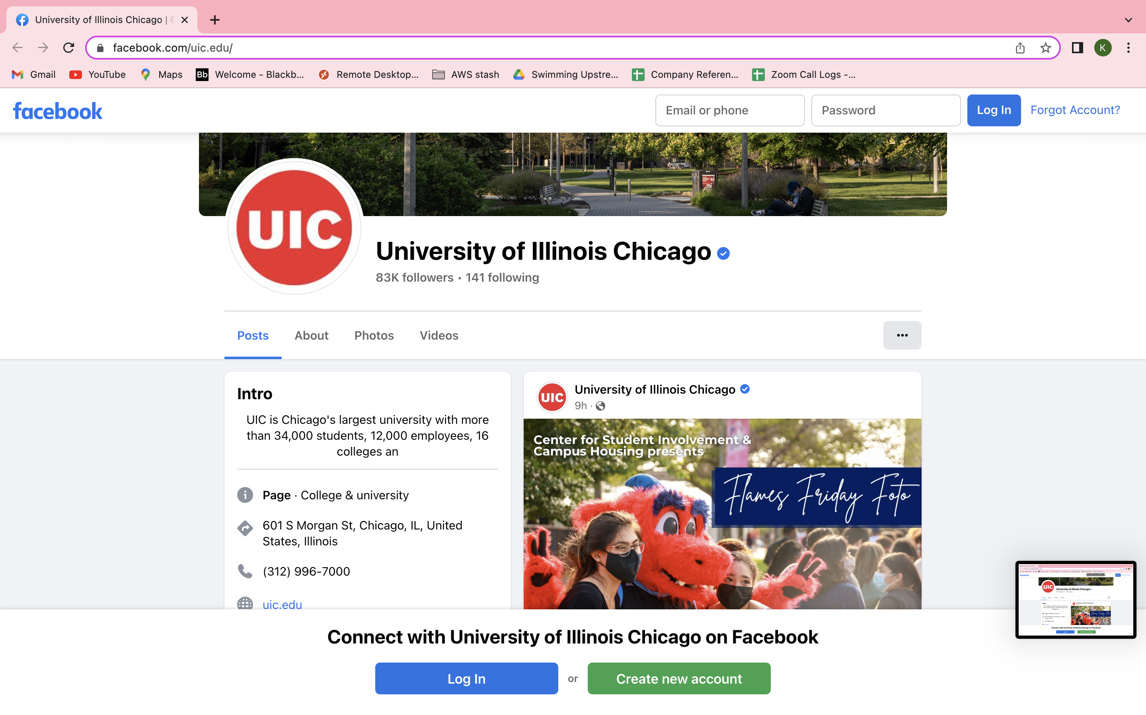
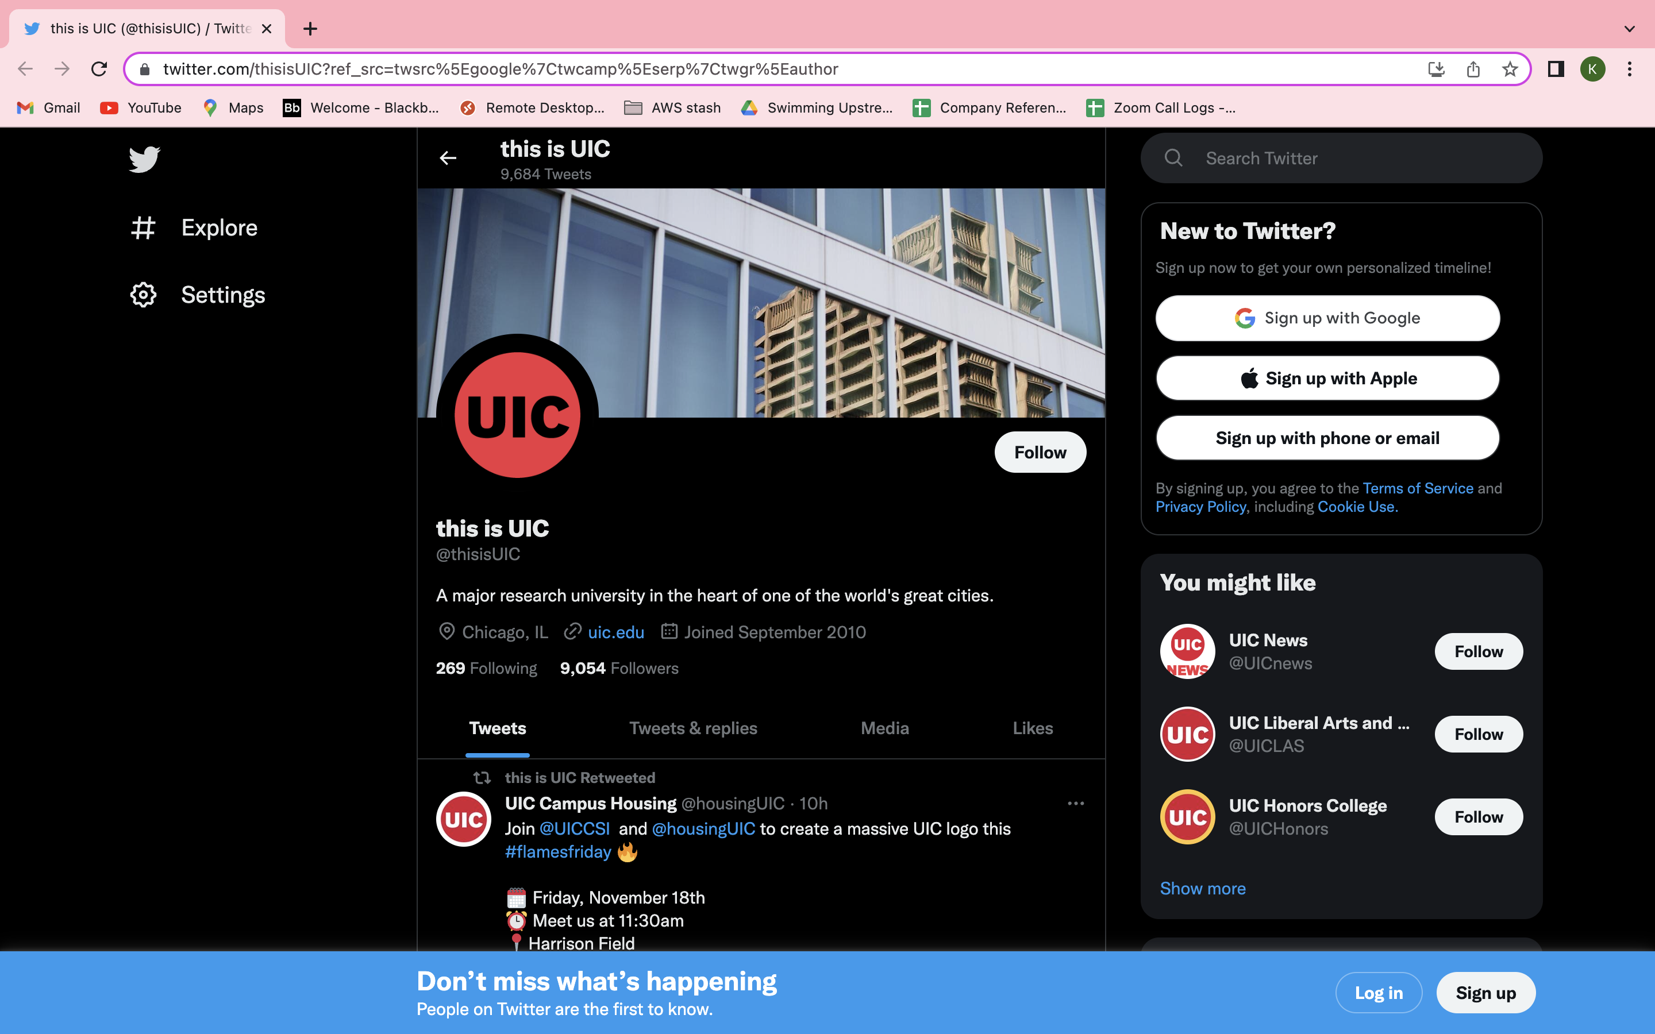
Application features
Navigation to Social media account

Slide 12

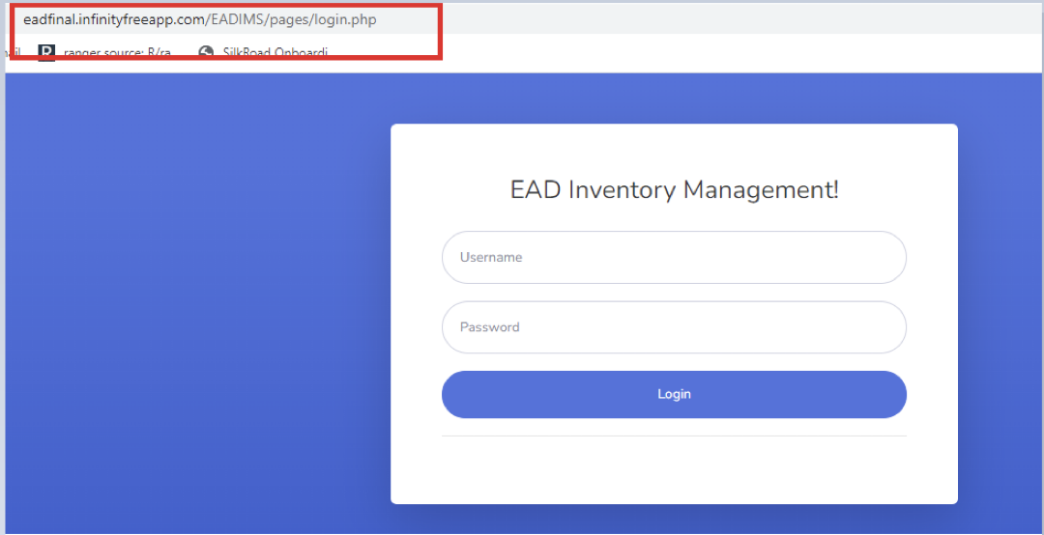
Application features
Inventory Management Login page

Slide 13

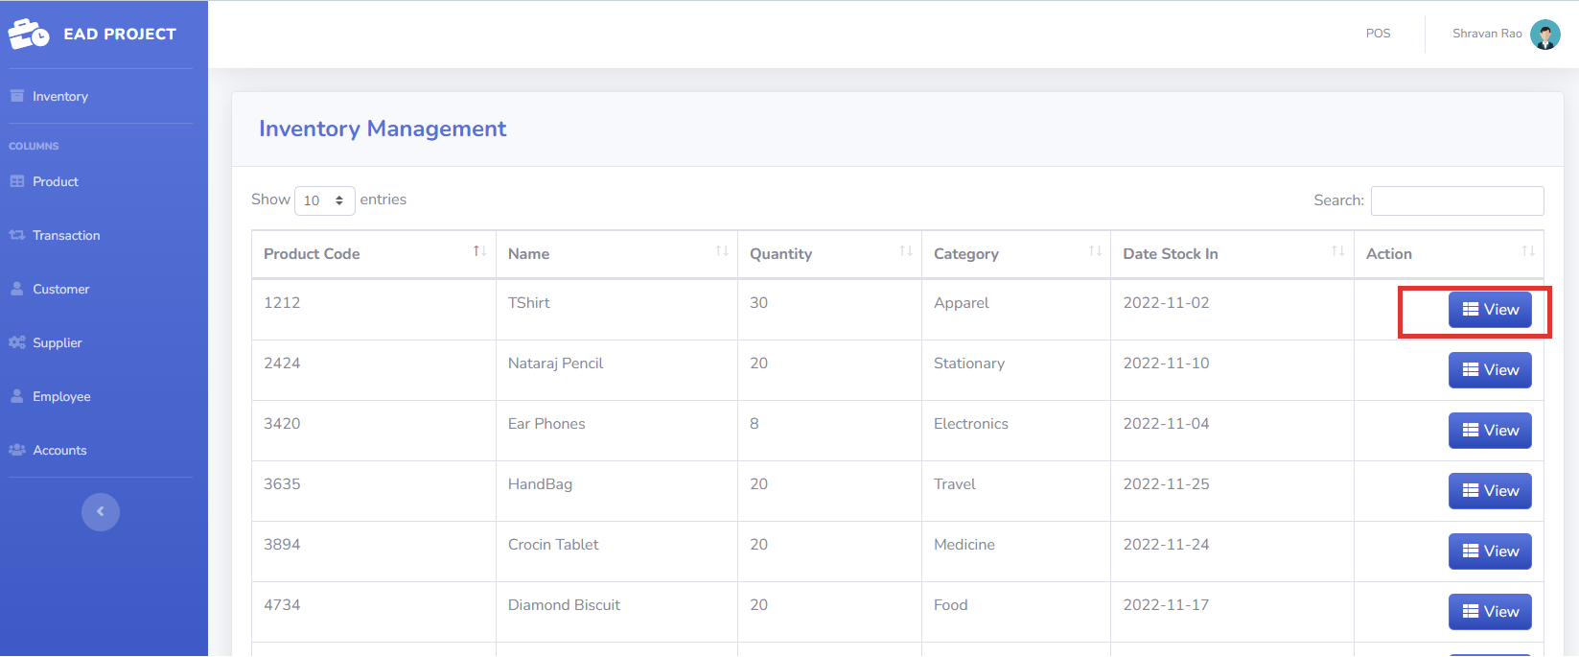
Application features
Inventory Management page

Slide 14

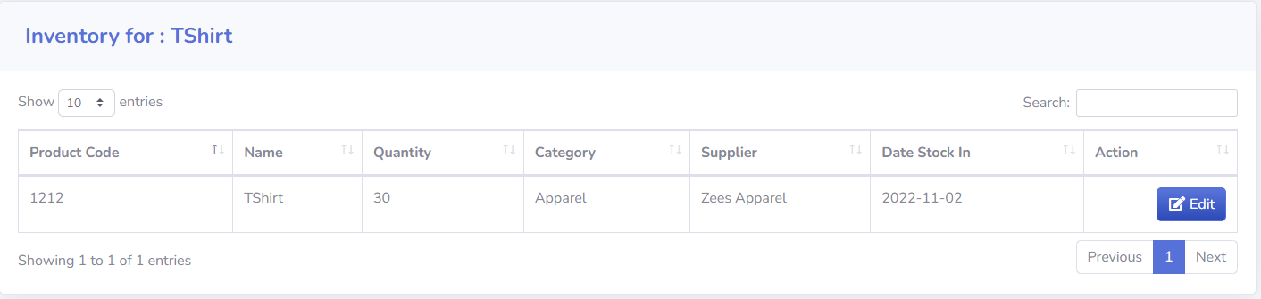
Application features
Clicking on View inventory Details

Slide 15

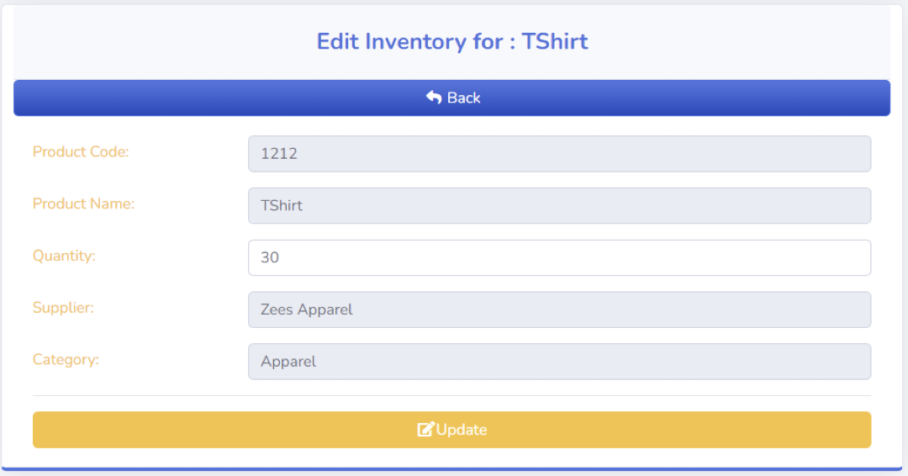
Application features
Click on Edit Inventory Details

Slide 16

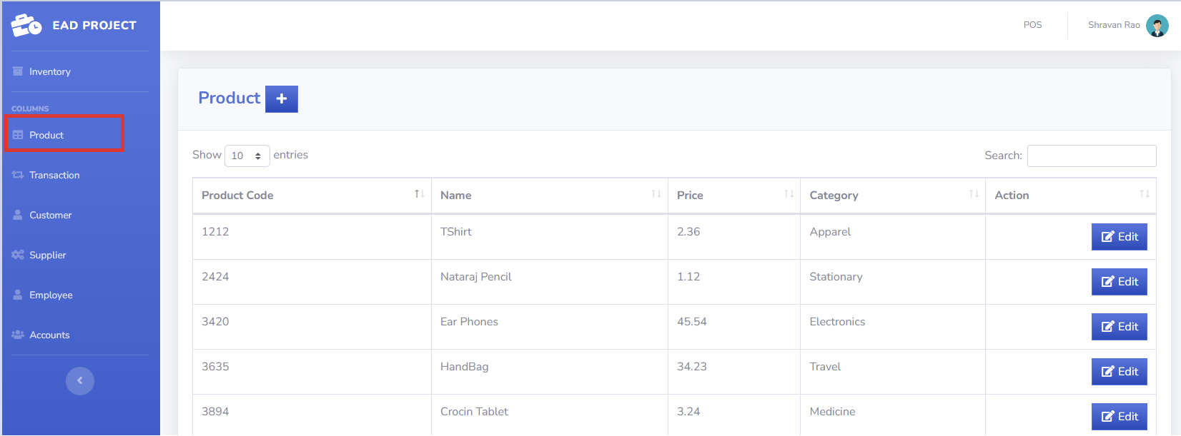
Application features
View all products

Slide 17
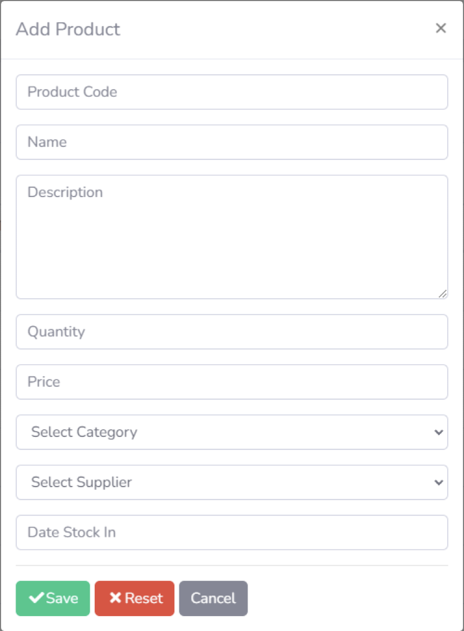
Application features
Add new product

Slide 18
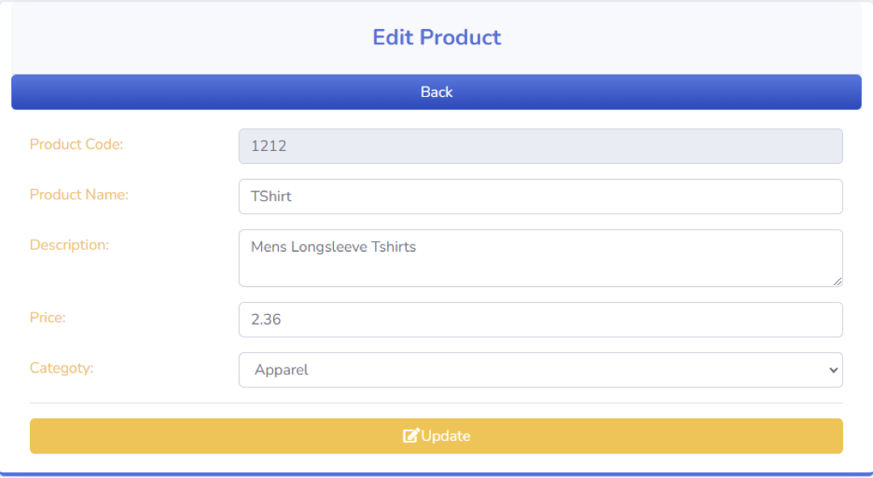
Application features
Editing Existing product

Slide 19

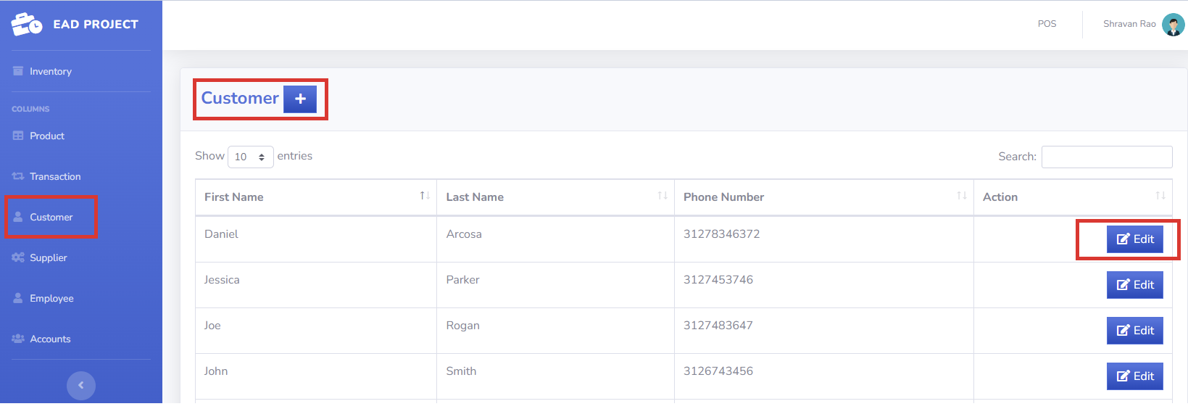
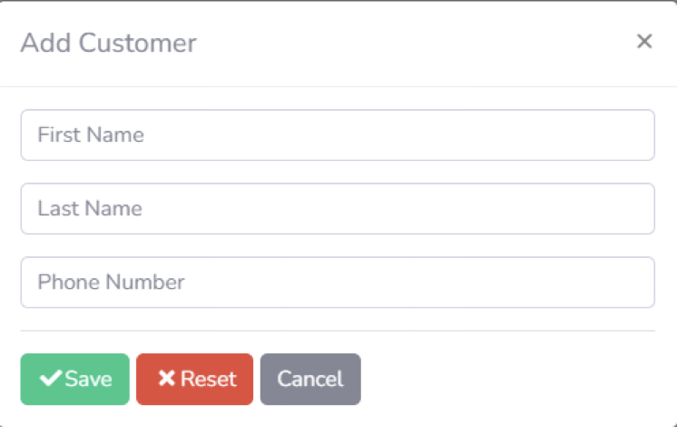

Application features
Customer Page
Adding Customer

Slide 20
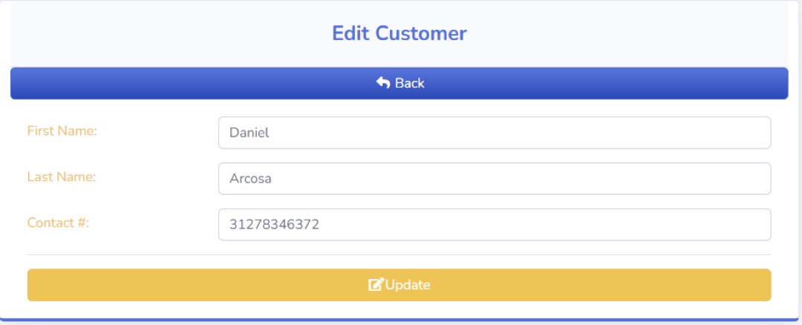
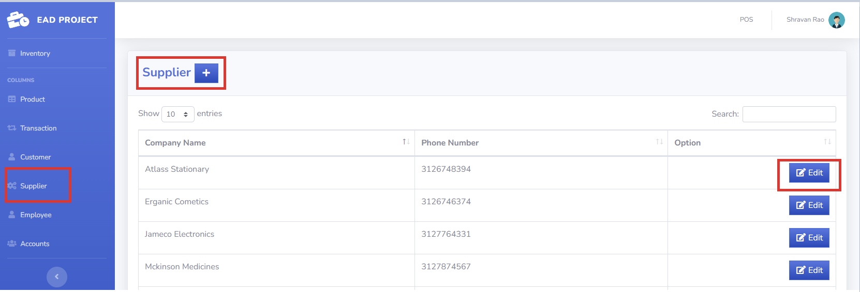

Application features
Editing Customers
Supplier List

Slide 21
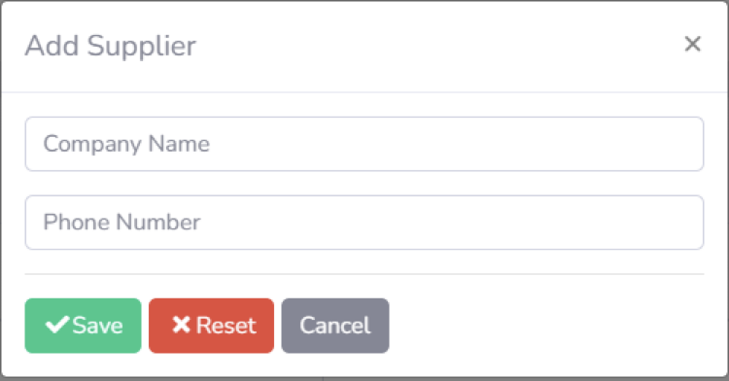
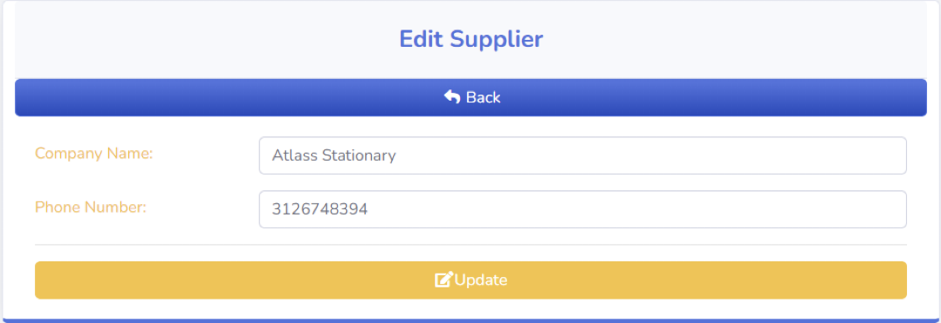
Application features
Adding new Supplier
Editing Existing Supplier

Slide 22

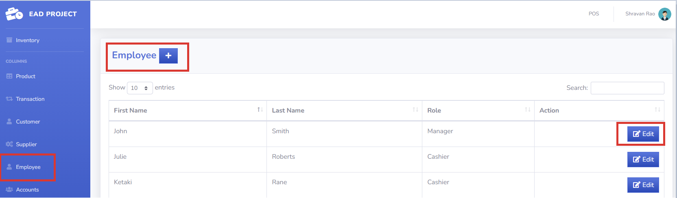
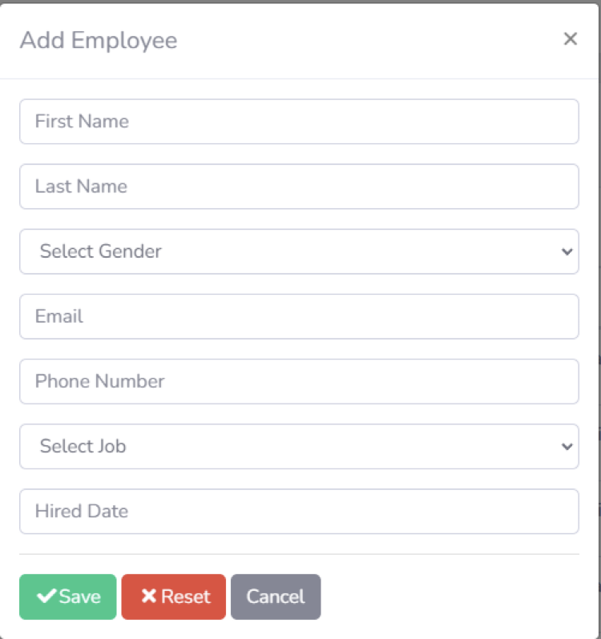
Application features
Employee List
Adding Employee

Slide 23
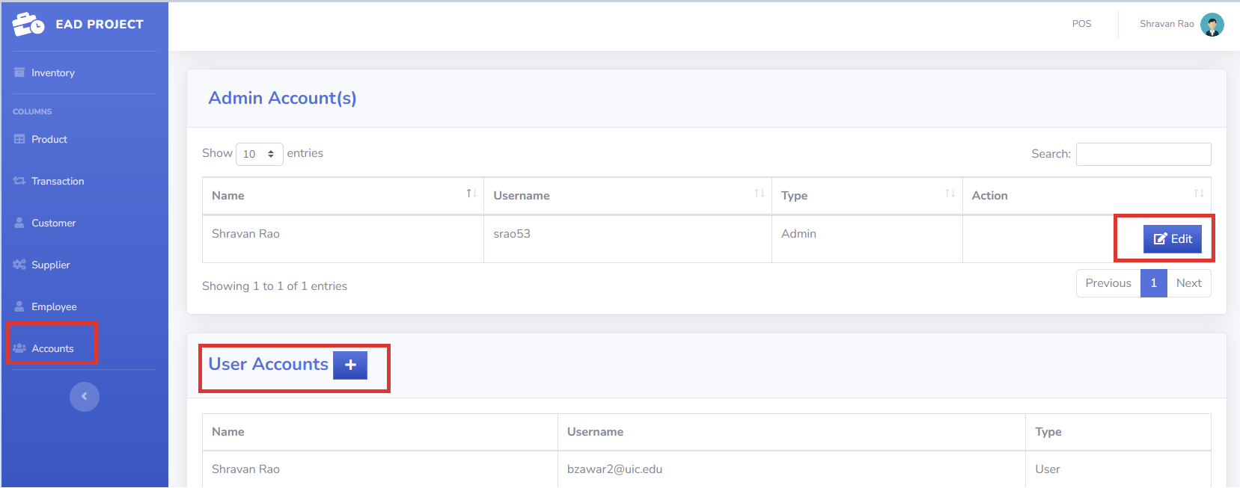

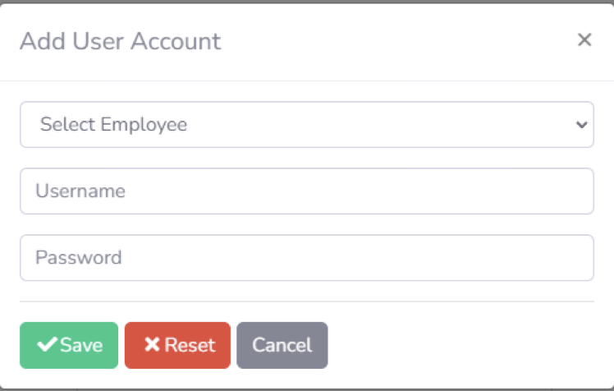
Application features
Accounts
Add user account

Slide 24
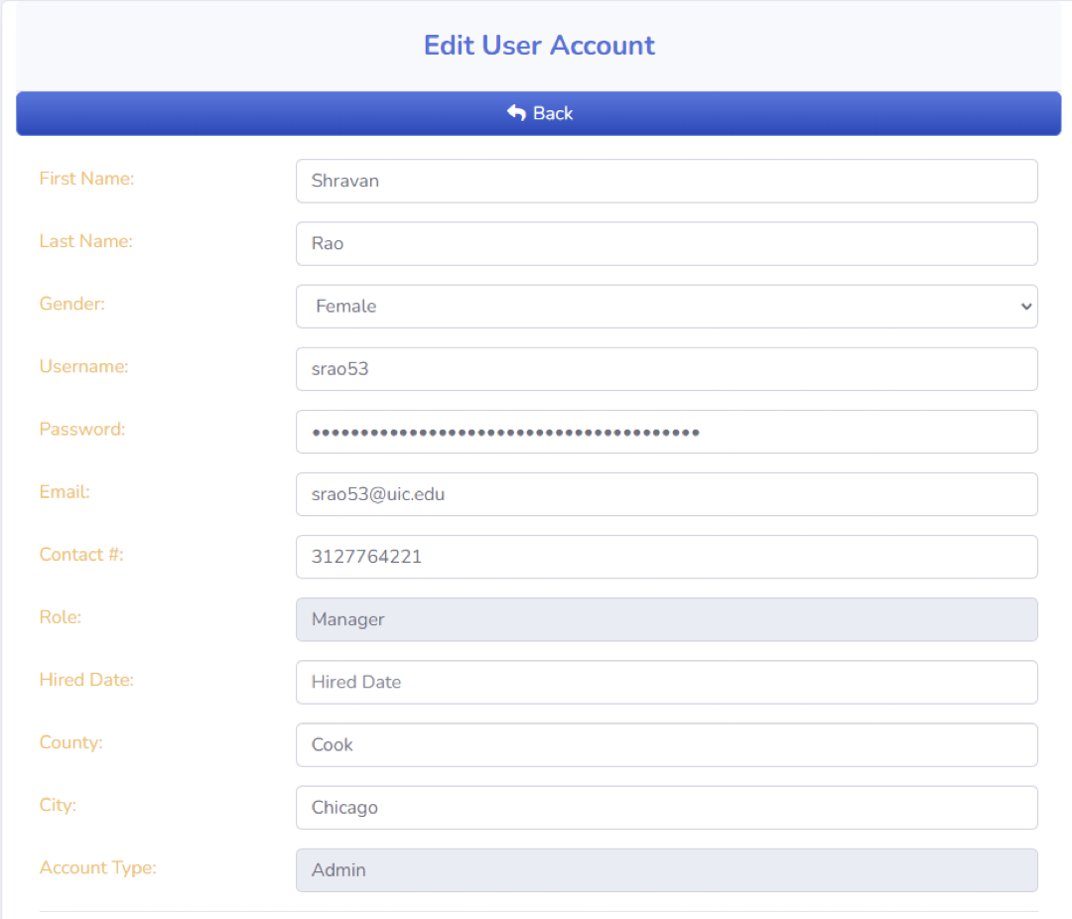

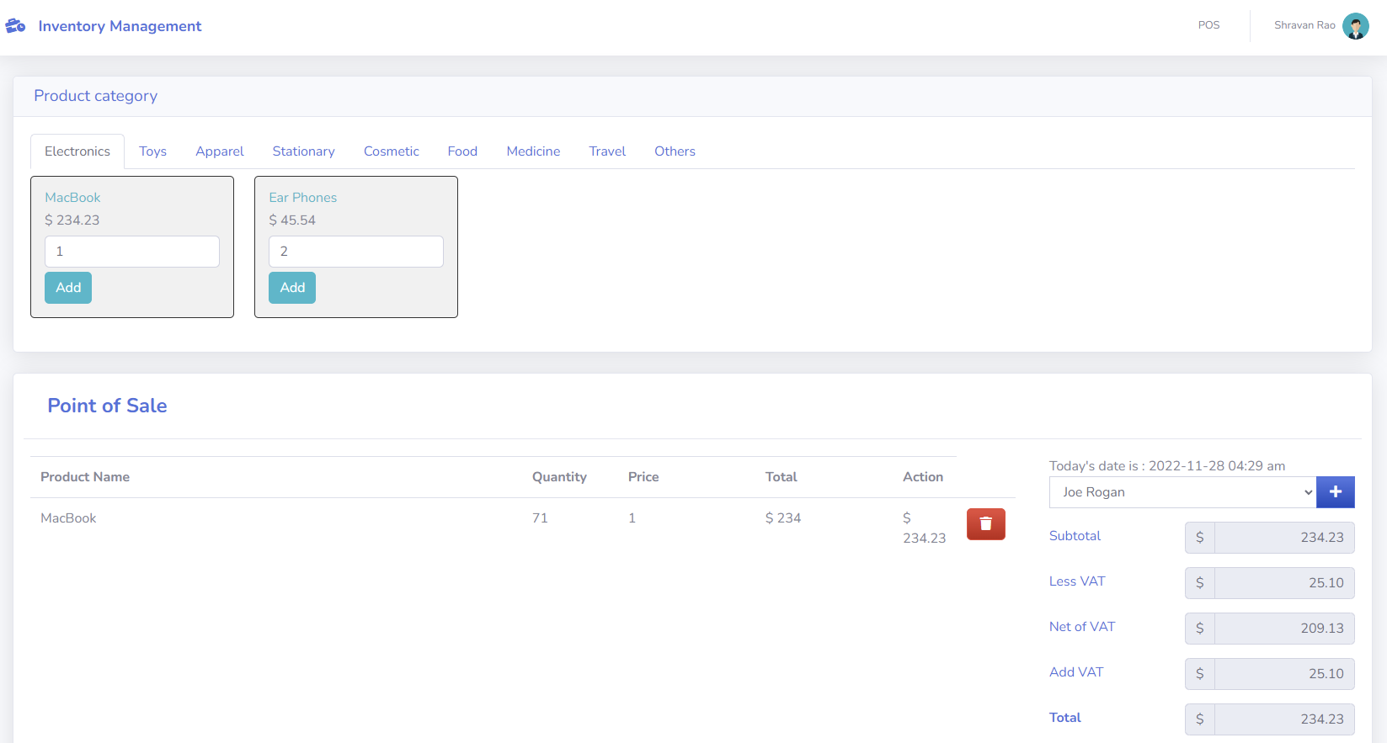

Application features
Edit user Account
Point of Sale

Slide 25
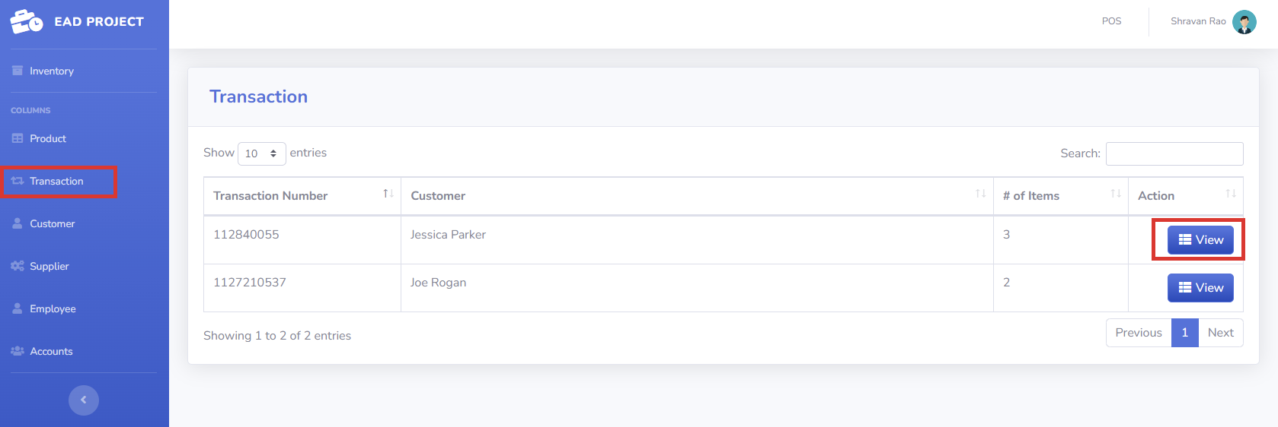

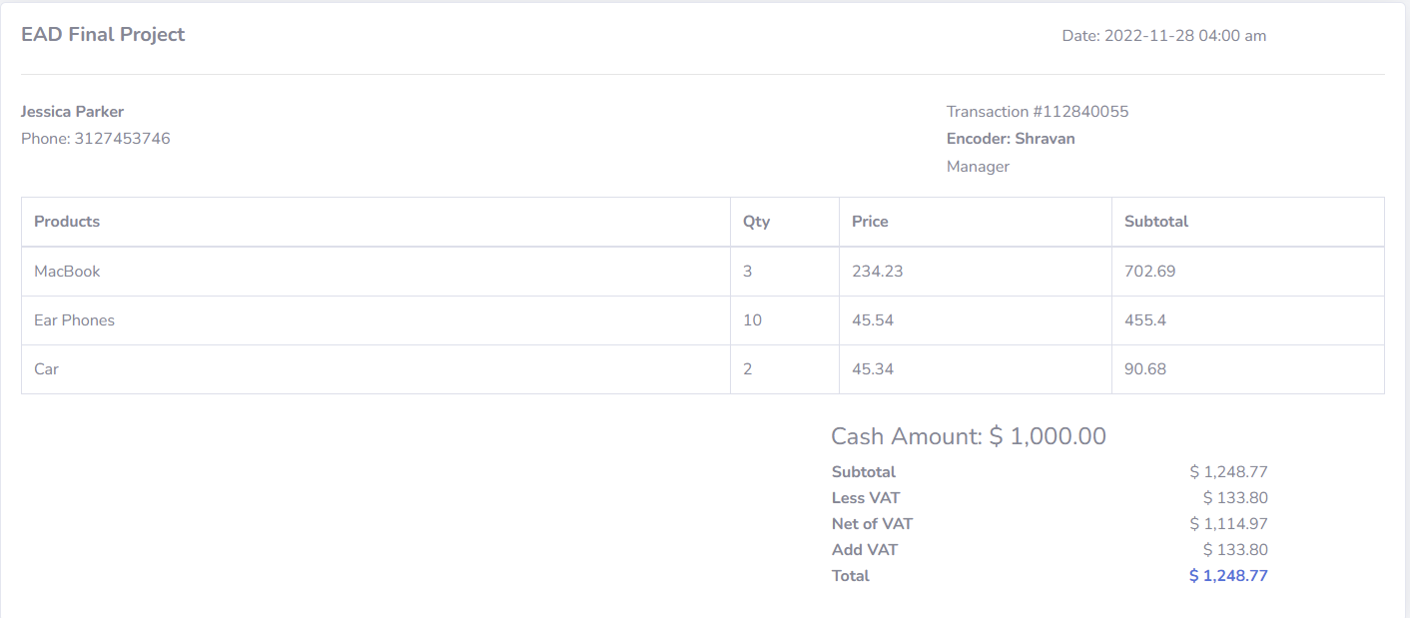
Application features
Transaction
After clicking on view

Slide 26


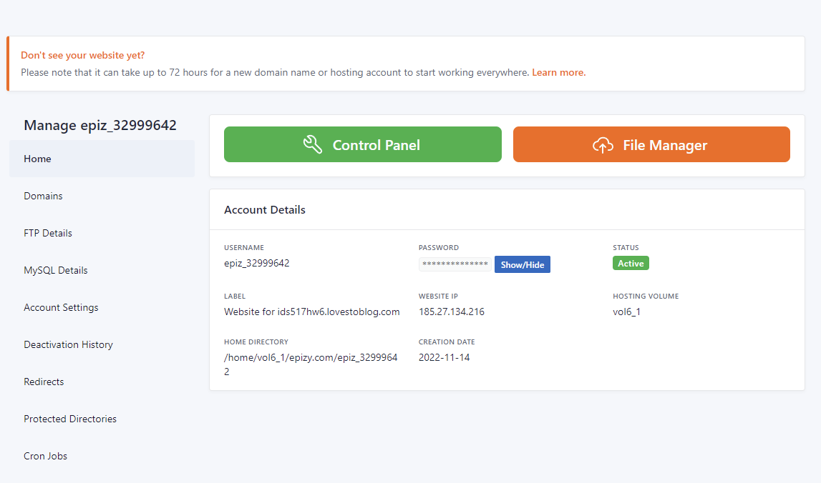
Web Hosting Environment
OS : Windows
Web Server : Infinity free
Infinityfree offers free web hosting with impressive marketing of unlimited disk space, bandwidth, and domain hosting.
Database : MySQL
Homepage
Source: https://digital.com/best-web-hosting/is-it-really-free/

Slide 27
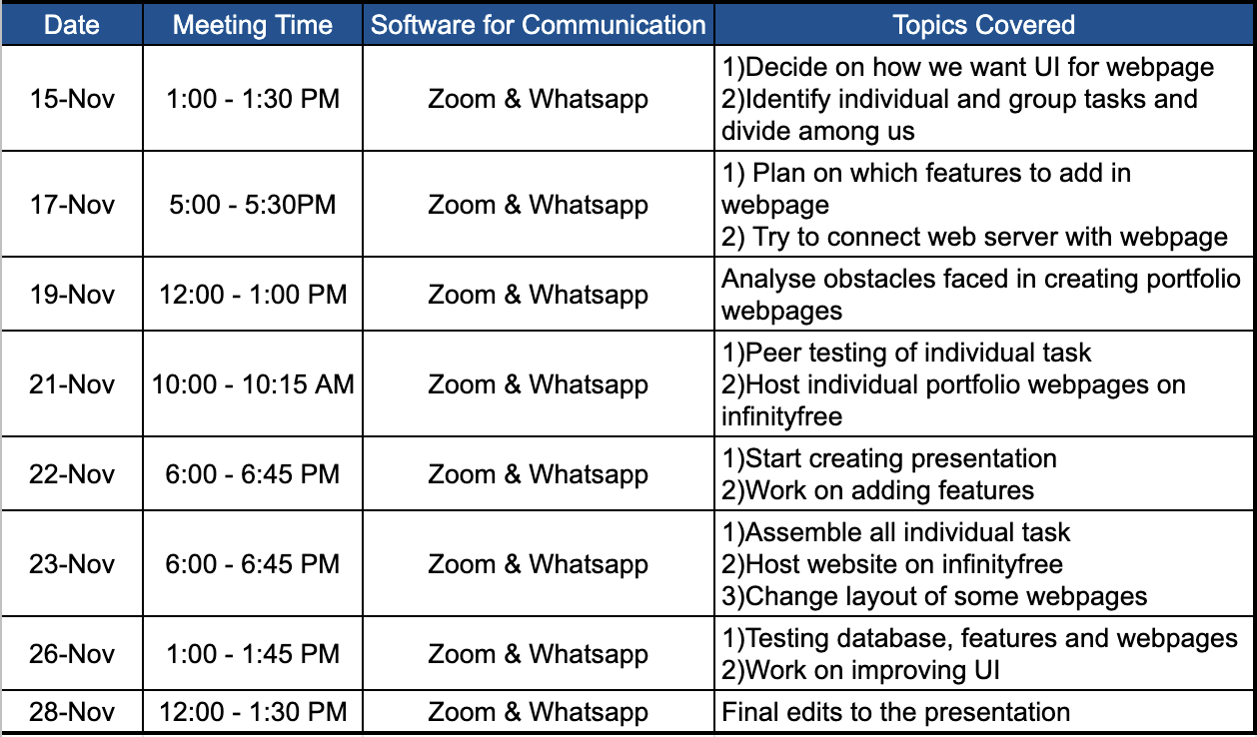



Meeting Logs
Team Engagement

Slide 28



Self-Evaluation
What went well -
The major goal of the assignment was to get exposure to web page development using HTML, CSS and JavaScript.
We not only achieved the primary purpose but also went on ahead with the interaction of the web page with the database using PHP and MySQL (via PHPMyAdmin).
Additionally, we have added individual pages to (Add/View/Update and Delete) for Customer, Inventory, Product, Transaction, Supplier, Employee and Accounts.
What cannot be done?
We have only implemented a Proof of Concept for Inventory Management (a user login page) which only allows to edit the Stock Quantity for the final project we can consider implementing all of the features of Assignment 4/5 onto the web page

Slide 29





Challenges Faced
Deciding web hosting Server
Various web hosting options were analyzed and then infinityfree was chosen owing to the website allowing 3 web domains for free
Web Page Development
Since many of us didn’t have exposure to front end web development. It was a steep curve to learn the nitty gritty involved in the same.
PHP Modules Debugging
Building PHP pages is quite straightforward on the local system but it becomes quite strenuous to identify if errors occur after deployment to server.

Slide 30

Thank You!

